Slide 1
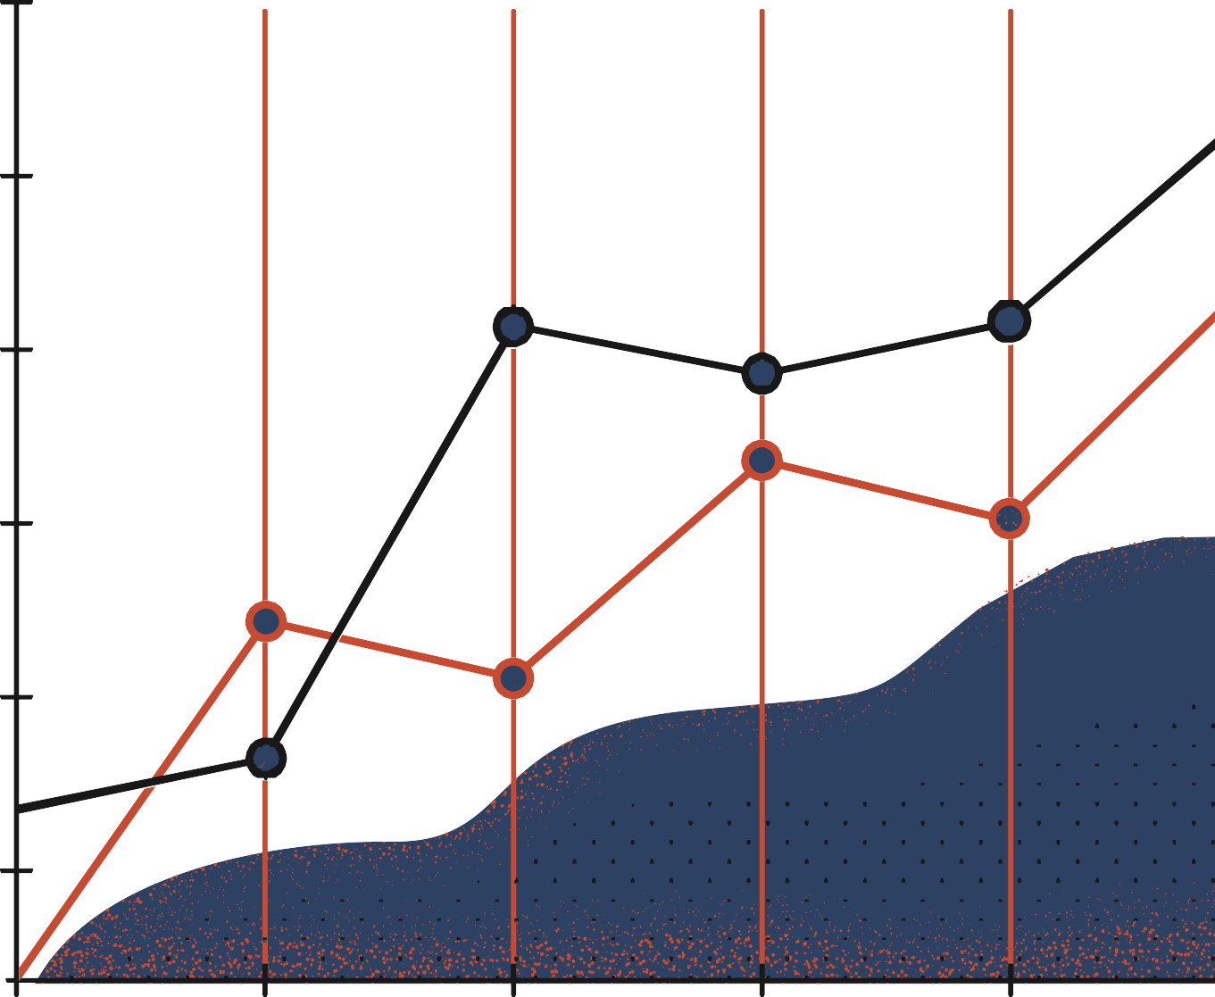


Anatomy of Neural Networks and Design Choices
Pavlos Protopapas

Slide 2
Outline
Anatomy of a NN
Design choices
Activation function
Loss function
Output units
Architecture

Slide 3
Outline
Anatomy of a NN
Design choices
Activation function
Loss function
Output units
Architecture

Slide 4
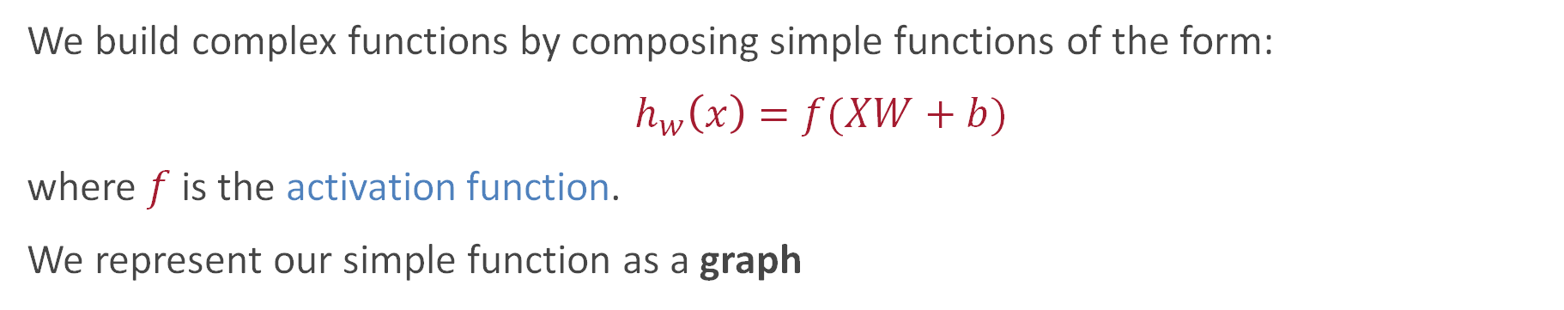
Graphical representation of simple functions
We build complex functions by composing simple functions of the form:
$h_{w}\left(x\right)=f(XW+b)$
where $f$ is the activation function.
We represent our simple function as a graph
Like sigmoid!
X₁
Each edge in this
graph represents
multiplication by
a different constant W_{d}
We call each W_{d}
a weight.
X₂
Y
X_{n}
Read left to right →

Slide 5
The zoo of neural network architectures
Backfed Input Cell
A complete chart of
NEURAL NETWORKS
Deep Feed Forward
Input Cell
Noisy Input Cell
Perceptron
Feed Forward
Radial Basis Network
Hidden Cell
Probabilistic Hidden Cell
Spiking Hidden Cell
Recurrent Neural Network
Long/Short Term Memory
Gated Recurrent Unit
Output Cell
Match Input Output Cell
Recurrent Cell
Memory Cell
AutoEncoder
Variational AE
Denoising AE
Sparse AE
Different Memory Cell
Markov Chain
Hopfield Network
Boltzmann Machine
Restricted BM
Deep Belief Network
6 neurons
50 neurons
100 neurons
500 neurons
200 neurons
Input Layer
Hidden Layers
Output
Different architectures result into functions with very different properties.
Larger networks can express more complex functions

Slide 6
Anatomy of artificial neural network (ANN)
OUTPUT LAYER
INPUT LAYER
HIDDEN LAYER 1
HIDDEN LAYER 2

Slide 7
Anatomy of artificial neural network (ANN)
OUTPUT LAYER
INPUT LAYER
HIDDEN LAYER 1
HIDDEN LAYER 2

Slide 8
Anatomy of artificial neural network (ANN)
Size of the INPUT is specified by the data
INPUT
OUTPUT LAYER
HIDDEN LAYER 1
HIDDEN LAYER 2

Slide 9
Anatomy of artificial neural network (ANN)
What activation function?
INPUT
OUTPUT LAYER
HIDDEN LAYER 1
HIDDEN LAYER 2

Slide 10
Anatomy of artificial neural network (ANN)
How many nodes per layer?
What activation function?
INPUT
OUTPUT LAYER
HIDDEN LAYER 1
HIDDEN LAYER 2

Slide 11
Anatomy of artificial neural network (ANN)
How many nodes per layer?
What activation function?
INPUT
OUTPUT LAYER
HIDDEN LAYER 1
HIDDEN LAYER 2
How many layers?

Slide 12
Anatomy of artificial neural network (ANN)
How many nodes per layer?
What activation function?
Type of output layer
INPUT
OUTPUT LAYER
HIDDEN LAYER 1
HIDDEN LAYER 2
How many layers?

Slide 13
Anatomy of artificial neural network (ANN)
How many nodes per layer?
What activation function?
Type of output layer
INPUT
LOSS
OUTPUT LAYER
What loss is appropriate?
HIDDEN LAYER 1
HIDDEN LAYER 2
How many layers?

Slide 14
Design Choices
Activation function
Loss function
Output units
Architecture

Slide 15

Activation Function
Activation functions are like traffic officers, managing the flow of information in neural networks.
They assess if a signal is strong enough to proceed, ensuring only relevant data moves forward.
Acting as gatekeepers, they determine whether a neuron activates or stays silent based on incoming signals.

Slide 16
Quiz Time
According to you, how should an activation function be structured? (Select all that apply)
It should be non-linear
It should be simple
It should ensure that the gradients remain large
It should restrict the range of the outputs

Slide 17
Quiz Time
According to you, how should an activation function be structured? (Select all that apply)
It should be non-linear
It should be simple
It should ensure that the gradients remain large
It should restrict the range of the outputs

Slide 18
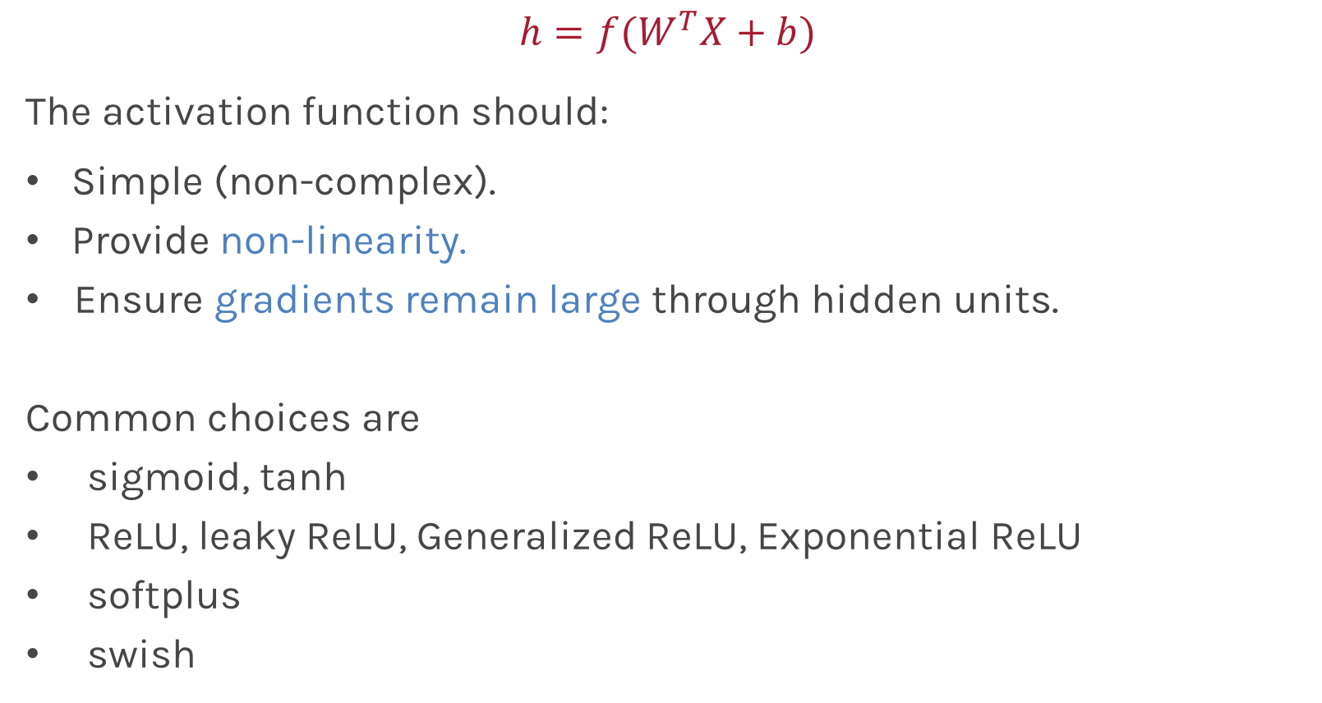
Activation function for hidden layers (not for the output unit)
$$h=f(W^{T}X+b)$$
The activation function should:
Simple (non-complex).
Provide non-linearity.
Ensure gradients remain large through hidden units.
Common choices are
sigmoid, tanh
ReLU, leaky ReLU, Generalized ReLU, Exponential ReLU
softplus
swish
Swish is called SiLU in Pytorch

Slide 19
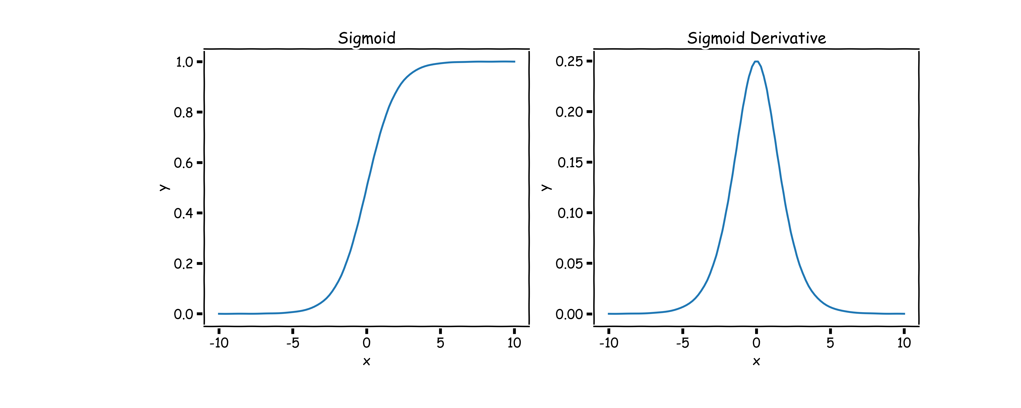
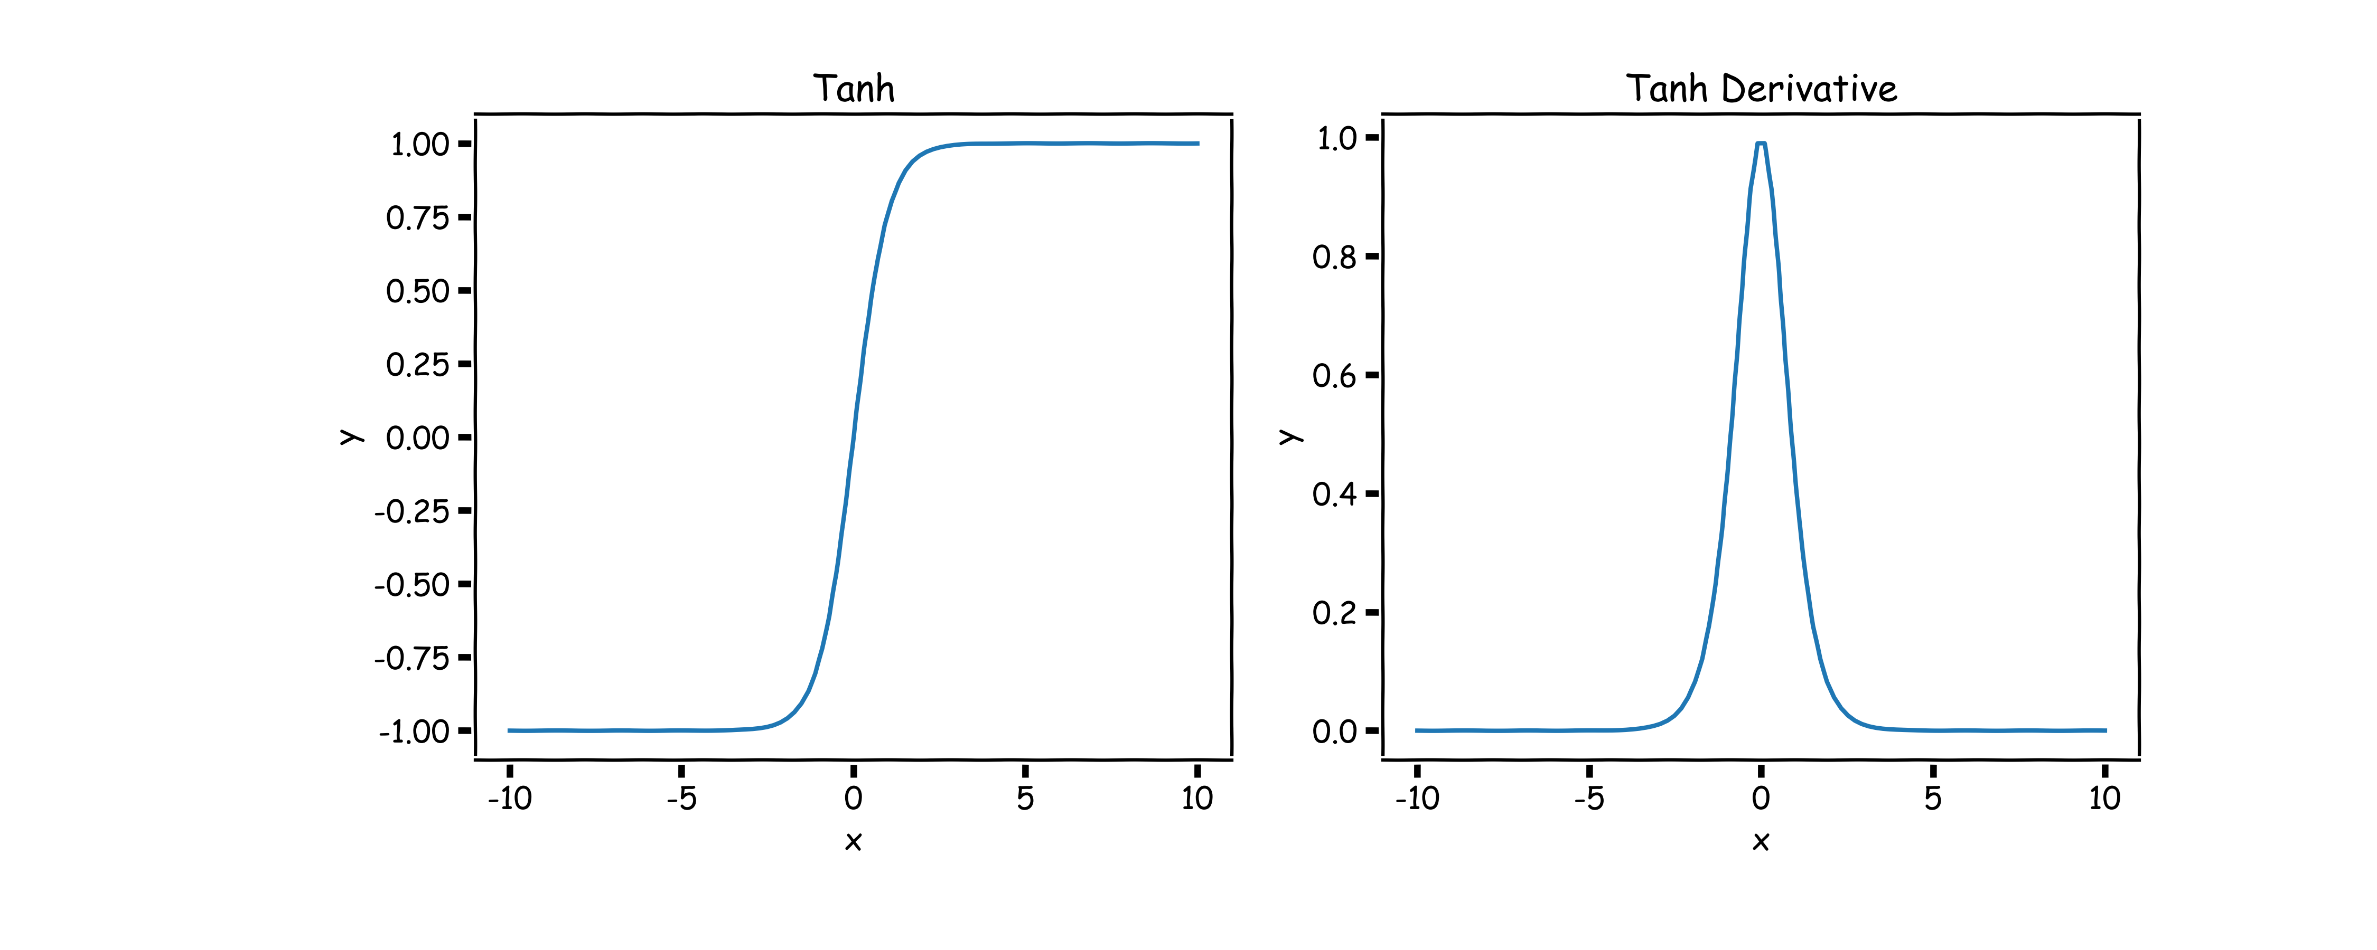
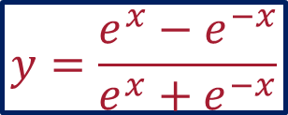
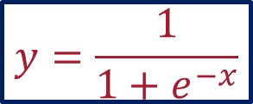
Sigmoid, $σ()$ (aka logistic) and tanh
$$y=\frac{1}{1+e^{−x}}$$
$$y=\frac{e^{x}−e^{−x}}{e^{x}+e^{−x}}$$
Derivative is zero for much of the domain. This leads to “vanishing gradients” in backpropagation.

Slide 20
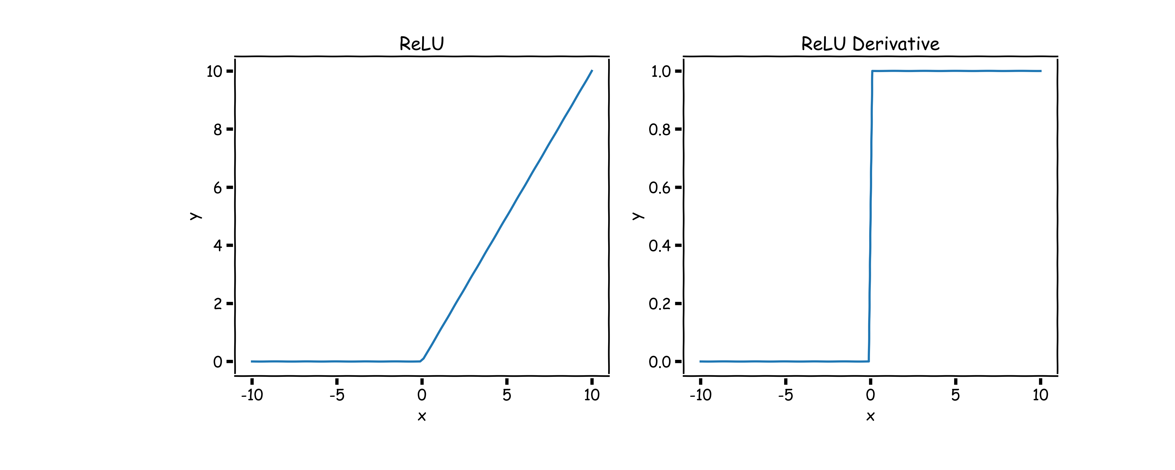
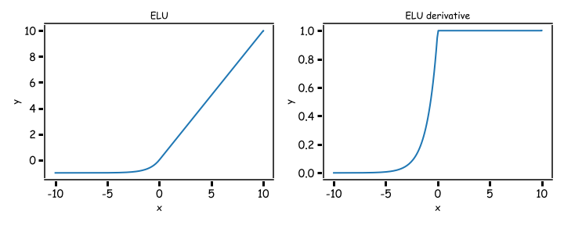
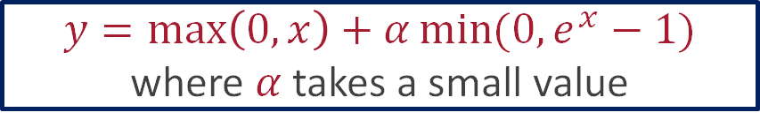
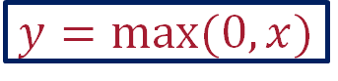
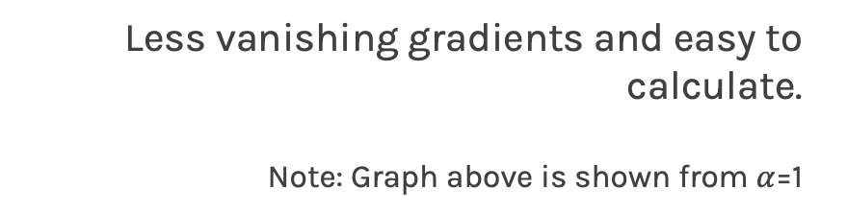
Rectified Linear Unit, ReLU(), Exponential ReLU (ELU)
$$y=\max\left(0,x\right)+α\min{(0,e^{x}−1)}$$
where $α$ takes a small value
$$y=max⁡(0,x)$$
Two major advantages:
No vanishing gradient when x > 0
Provides sparsity (regularization) since
y = 0 when x < 0
Less vanishing gradients and easy to calculate.
Note: Graph above is shown from $α$=1

Slide 21
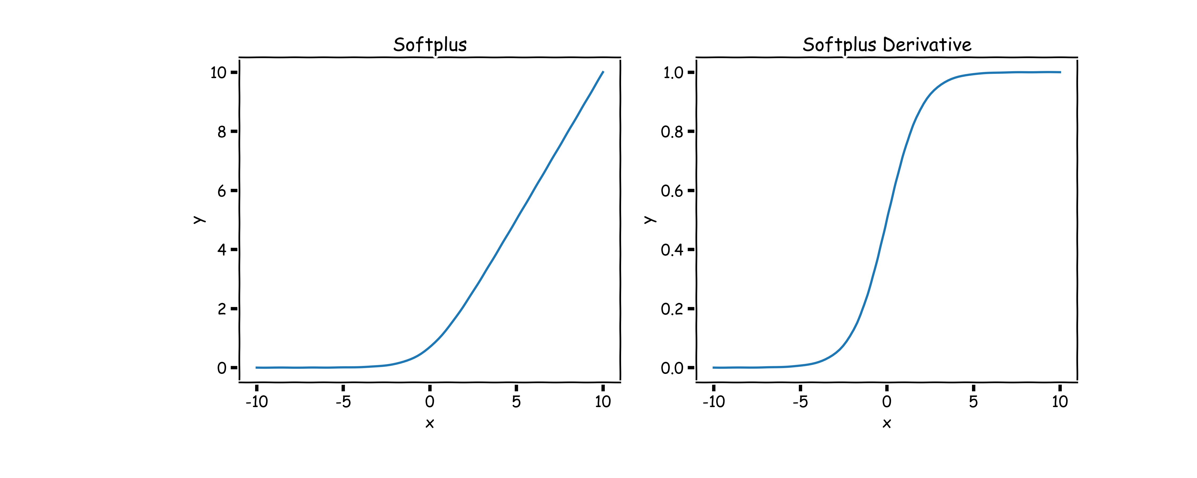
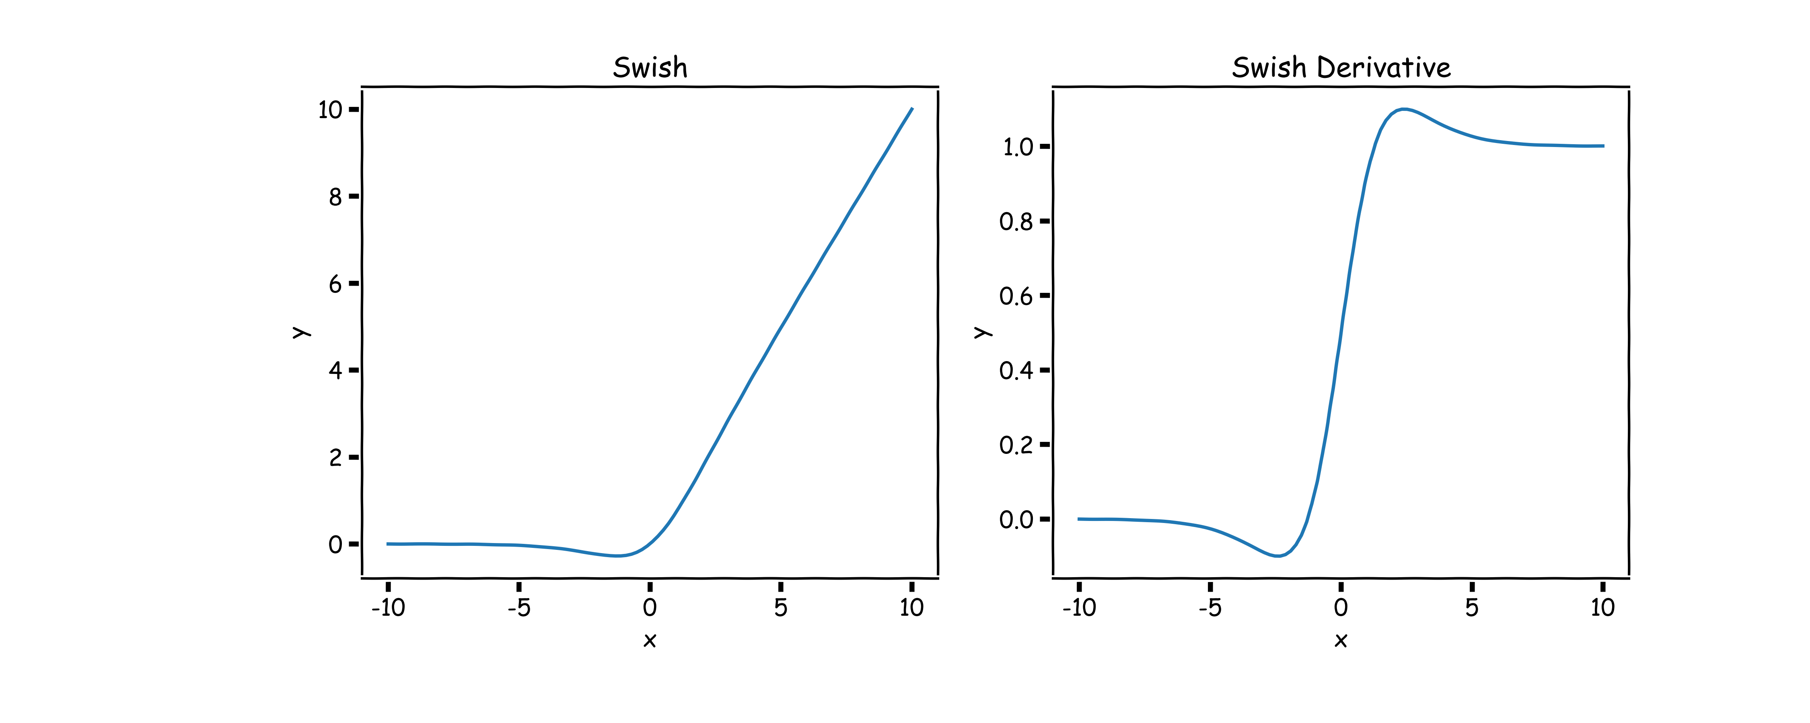
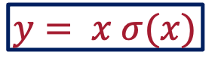
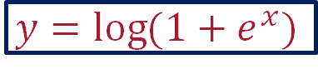
Softplus and Swish
$$y=\log{(1+e^{x})}$$
$$y= x σ(x)$$
The derivative of the softplus is the sigmoid logistic function, which is a smooth approximation of the derivative of the rectifier. So, the derivative of the softplus is continuous.
Swish tends to work better than ReLU on deeper models across several challenging datasets.

Slide 22

TL; DR
Activation Function Demo!
Visualising Activation Functions in Neural Networks - David Sheehan

Slide 23
Design Choices
Activation function
Loss function
Output units
Architecture

Slide 24
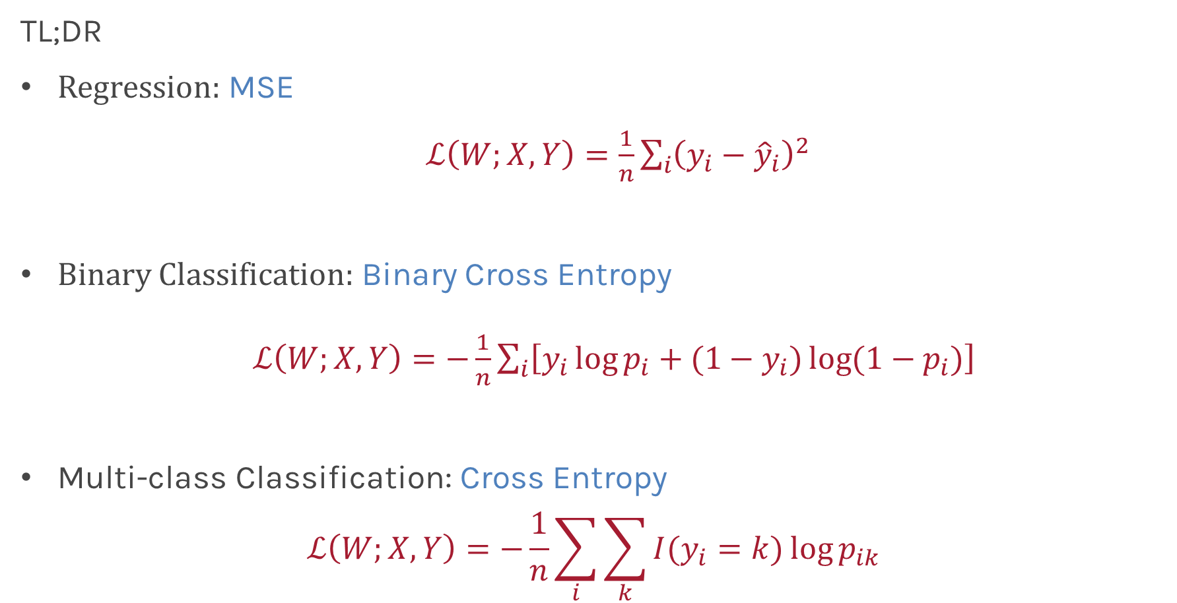
Loss Function
TL;DR
Regression: MSE
$ℒ\left(W;X, Y\right)=\frac{1}{n}\sum_{i}{{\left(y_{i}−{\hat{y}}_{i}\right)}^{2}}$
Binary Classification: Binary Cross Entropy
$ℒ\left(W;X, Y\right)=−\frac{1}{n}\sum_{i}{\left[y_{i}\log{p_{i}}+{(1−y}_{i})\log{(1−p_{i})}\right] }$
Multi-class Classification: Cross Entropy
$$ℒ\left(W;X, Y\right)=−\frac{1}{n}\sum_{i}{\sum_{k}{I(y_{i}=k)}\log{p_{ik}}}$$

Slide 25
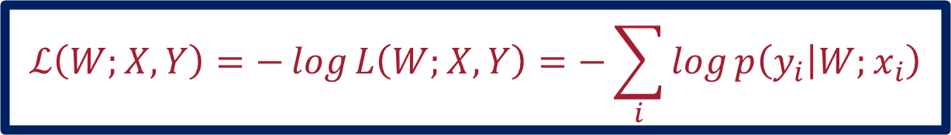
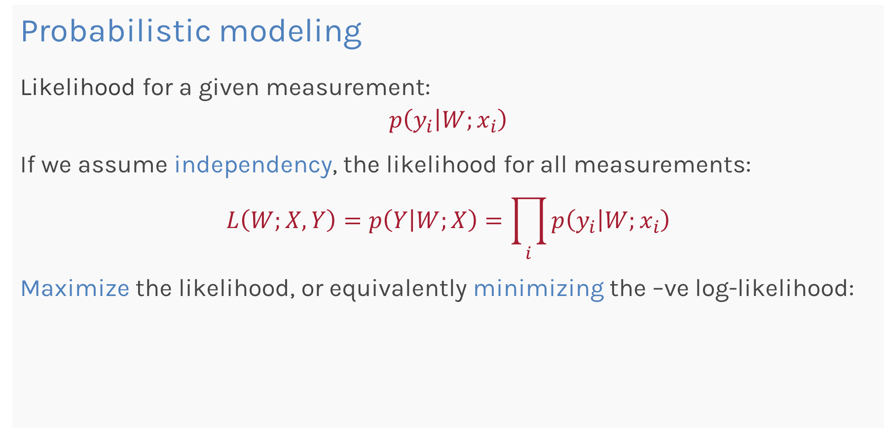
Loss Function
Probabilistic modeling
Likelihood for a given measurement:
$$p\left(y_{i} | W;x_{i}\right)$$
If we assume independency, the likelihood for all measurements:
$$L\left(W;X,Y\right)=p\left(Y | W;X\right)=\prod_{i}{p\left(y_{i} | W;x_{i}\right)}$$
Maximize the likelihood, or equivalently minimizing the –ve log-likelihood:
$$ℒ\left(W;X, Y\right)=−\log{L\left(W;X,Y\right)=−\sum_{i}{\log{p\left(y_{i} | W;x_{i}\right)}}}$$

Slide 26
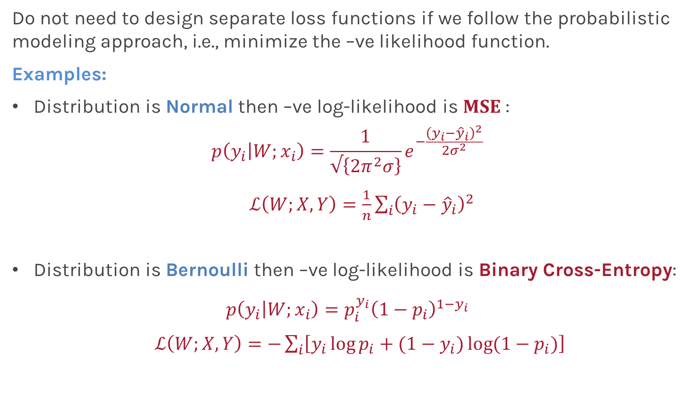
Loss Function
Do not need to design separate loss functions if we follow the probabilistic modeling approach, i.e., minimize the –ve likelihood function.
Examples:
Distribution is Normal then –ve log-likelihood is $MSE$:
$$p\left(y_{i} | W;x_{i}\right)=\frac{1}{√\left\{2π^{2}σ\right\}}e^{−\frac{{\left(y_{i}−{\hat{y}}_{i}\right)}^{2}}{2σ^{2}}}$$
$ℒ\left(W;X, Y\right)=\frac{1}{n}\sum_{i}{{\left(y_{i}−{\hat{y}}_{i}\right)}^{2}}$
Distribution is Bernoulli then –ve log-likelihood is Binary Cross-Entropy:
$$p\left(y_{i} | W;x_{i}\right)=p_{i}^{y_{i}}{\left(1−p_{i}\right)}^{1−y_{i}}$$
$ℒ\left(W;X, Y\right)=−\sum_{i}{\left[y_{i}\log{p_{i}}+{(1−y}_{i})\log{(1−p_{i})}\right] }$

Slide 27
Design Choices
Activation function
Loss function
Output units
Architecture

Slide 28
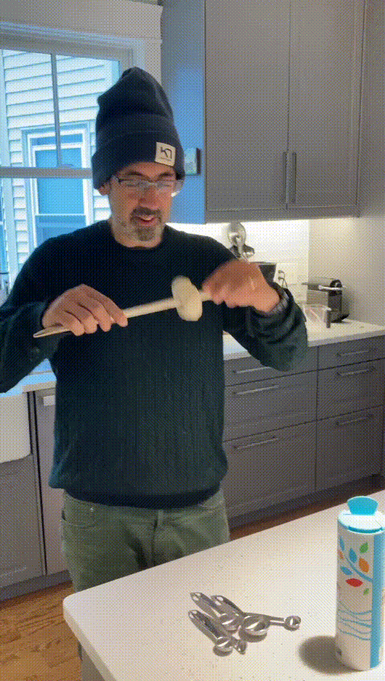

Output Units
Think of a neural network as a master chef preparing a donut.
The output units are like the finished donuts that are served to the customers.
The master chef

Slide 29
Output Units
Output Type | Output Distribution | Output layer | Loss Function
Binary | Bernoulli | ? | Binary Cross Entropy

Slide 30
Output Units - Binary Classification
X
OUTPUT UNIT

Slide 31
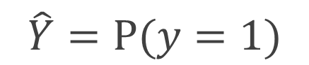
Output Units - Binary Classification
P(Y=1) must be [0,1]
X
$$\hat{Y}=P(y=1)$$
OUTPUT UNIT

Slide 32
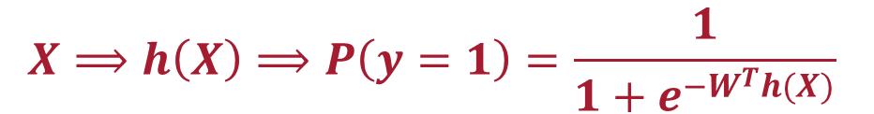


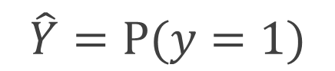
Output Units - Binary Classification
P(Y=1) must be [0,1]
X
$$\hat{Y}=P(y=1)$$
OUTPUT UNIT
X
$$σ(W^{T}h(X))$$
$$\hat{Y}=P(y=1)$$
$$h\left(X\right)$$
$$X⟹h\left(X\right)⟹P\left(y=1\right)=\frac{1}{1+e^{−W^{T}h(X)}}$$

Slide 33
Output Units
Output Type | Output Distribution | Output layer | Loss Function
Binary | Bernoulli | Sigmoid | Binary Cross Entropy

Slide 34
Output Units
Output Type | Output Distribution | Output layer | Loss Function
Binary | Bernoulli | Sigmoid | Binary Cross Entropy
Discrete | Multinouli | ? | Cross Entropy

Slide 35
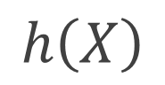
Output Units – Multiclass Classification (ex: 3 classes)
$$h\left(X\right)$$
A score
REST OF THE NETWORK
B score
C score

Slide 36
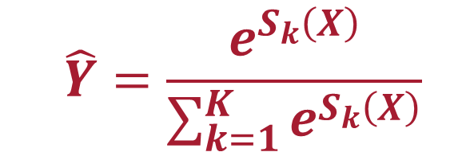
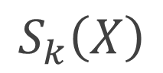
Output Units – Multiclass Classification (ex: 3 classes)
Logits
$$\hat{Y}=\frac{e^{S_{k}\left(X\right)}}{\sum_{k=1}^{K}{e^{S_{k}\left(X\right)}}}$$
$$h\left(X\right)$$
$$S_{k}\left(X\right)$$
A score
SoftMax
Probability of A
REST OF THE NETWORK
B score
Probability of B
C score
Probability of C

Slide 37
Output Units – Multiclass Classification (ex: 3 classes)
Logits
$$\hat{Y}=\frac{e^{S_{k}\left(X\right)}}{\sum_{k=1}^{K}{e^{S_{k}\left(X\right)}}}$$
$$h\left(X\right)$$
$$S_{k}\left(X\right)$$
A score
SoftMax
Probability of A
REST OF THE NETWORK
B score
Probability of B
C score
Probability of C
NOTE : In the case of multiclass classification, the number of output units will always be the same as the number of classes in the response variable.

Slide 38
Output Units
Output Type | Output Distribution | Output layer | Loss Function
Binary | Bernoulli | Sigmoid | Binary Cross Entropy
Discrete | Multinoulli | Softmax | Cross Entropy

Slide 39
Output Units
Output Type | Output Distribution | Output layer | Loss Function
Binary | Bernoulli | Sigmoid | Binary Cross Entropy
Discrete | Multinoulli | Softmax | Cross Entropy
Continuous | Gaussian | ? | MSE

Slide 40


Output Units - Regression
$\hat{Y}$ is not bounded!
X
$$\hat{Y}$$
OUTPUT UNIT

Slide 41
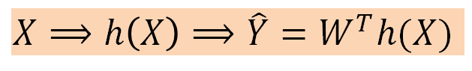


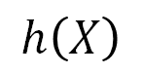
Output Units - Regression
X
$$\hat{Y}$$
OUTPUT UNIT
X
$$h\left(X\right)$$
$$W^{T}h(X)$$
$$\hat{Y}$$
$$X⟹h\left(X\right)⟹\hat{Y}=W^{T}h(X)$$

Slide 42
Output Units
Output Type | Output Distribution | Output layer | Loss Function
Binary | Bernoulli | Sigmoid | Binary Cross Entropy
Discrete | Multinoulli | Softmax | Cross Entropy
Continuous | Gaussian | Linear | MSE

Slide 43
Design Choices
Activation function
Loss function
Output units
Architecture

Slide 44


Architecture

Slide 45
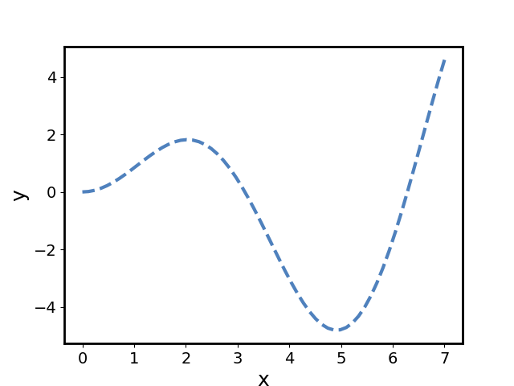
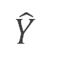
Number of nodes
Hidden
(1 ReLU Unit)
Output(linear)
Input
$$\hat{Y}$$
real xsin(x)
pred

Slide 46

Number of nodes
Hidden (20 ReLU units)
Output
(linear)
Input
$\hat{Y}$
real xsin(x)
pred

Slide 47
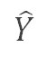
Layers
Hidden (ReLU)
Hidden (ReLU)
Output
(linear)
Input
$$\hat{Y}$$
real xsin(x)
pred

Slide 48

Layers
Hidden (ReLU)
Hidden (ReLU)
Hidden (ReLU)
Output
(linear)
Input
$$\hat{Y}$$
real xsin(x)
pred

Slide 49
Neural Networks as Universal Approximators
We have seen that neural networks can represent complex functions, but are there limitations on what a neural network can express?
Theorem:
For any continuous function f defined on a bounded domain, we can find a neural network that approximates f with an arbitrary degree of accuracy.

Slide 50

Layers
One hidden layer is enough to represent an approximation of any function to an arbitrary degree of accuracy.
So, the question in your mind must be:
Why go deeper?

Slide 51
Quiz Time
Why do you think we need more layers?
To avoid overfitting
To enable the network to learn complex patterns through a hierarchical learning process step by step.
It is computationally faster
It works prof! I do not need to know why

Slide 52
Quiz Time
Why do you think we need more layers?
To avoid overfitting
To enable the network to learn complex patterns through a hierarchical learning process step by step.
It is computationally faster
It works prof! I do not need to know why

Slide 53
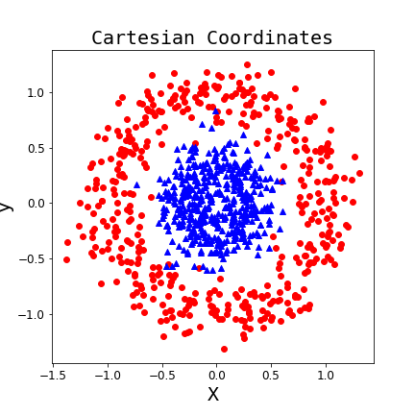
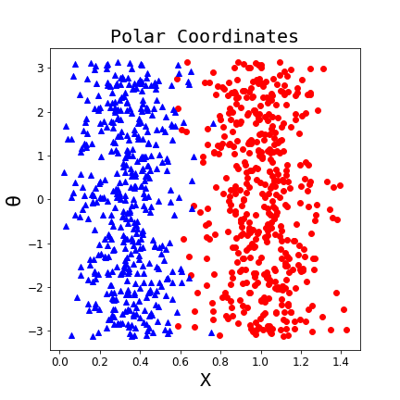
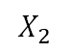
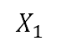
Why layers?
Representation matters!
$$X_{2}$$
$$X_{1}$$
Neural networks can learn useful representations for the problem. This is another reason why they can be so powerful!
Notes:
X1 and x2

Slide 54
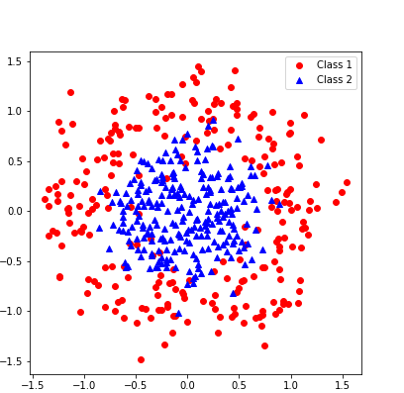
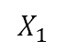
$$X_{2}$$
$$X_{1}$$

Slide 55
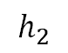
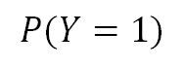
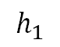
input
hidden₁
hidden₂
output
$$h_{1}$$
$$X_{2}$$
$$P(Y=1)$$
$$h_{2}$$
$$X_{1}$$

Slide 56
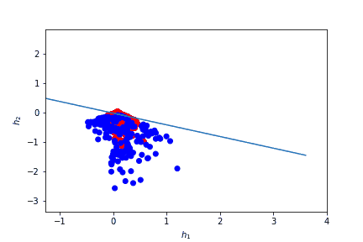
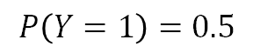
input
hidden₁
hidden₂
output
$$h_{1}$$
$$X_{2}$$
$$P(Y=1)$$
$$h_{2}$$
$$P\left(Y=1\right)=0.5$$
$$X_{1}$$

Slide 57
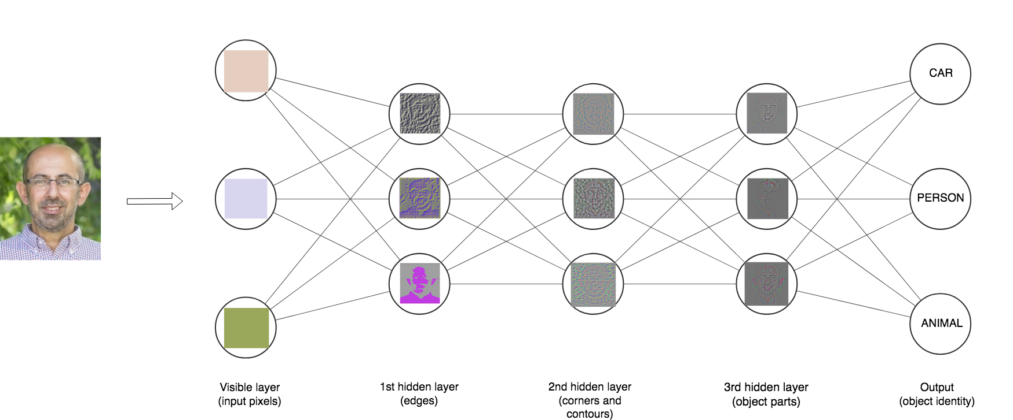

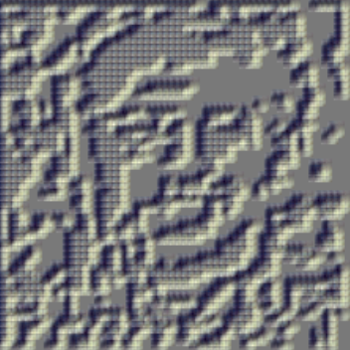
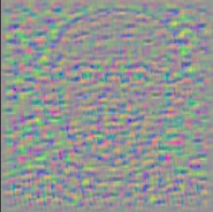


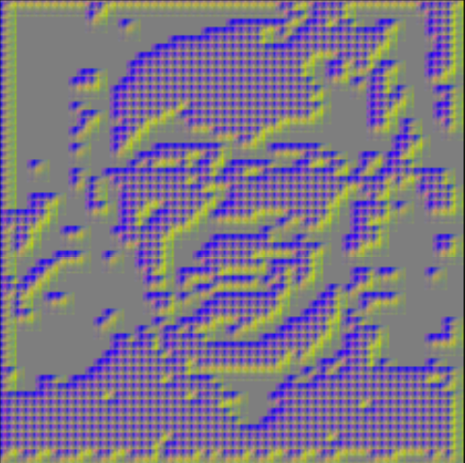
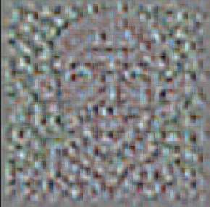
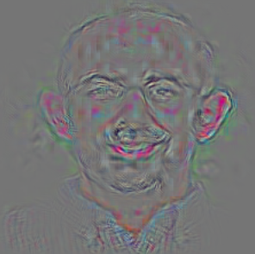
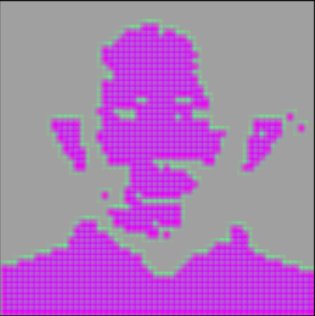



Depth Intuition

Slide 58

Shallow vs Deep Nets
Depth helps, and it’s not just because of more parameters
(Goodfellow 2017)

Slide 59
Shallow vs Deep Nets
Depth helps, and it’s not just because of more parameters
(Goodfellow 2017)
The 11-layer net generalizes better on the test set when controlling for number of parameters.

Slide 60
Shallow vs Deep Nets
Depth helps, and it’s not just because of more parameters
(Goodfellow 2017)
The 11-layer net generalizes better on the test set when controlling for number of parameters.
The 3-layer nets perform worse on the test set, even with similar number of total parameters.

Slide 61
Shallow vs Deep Nets
Depth helps, and it’s not just because of more parameters
Don’t worry about this word “convolutional”. It’s just a special type of neural network, often used for images.
(Goodfellow 2017)
The 11-layer net generalizes better on the test set when controlling for number of parameters.
The 3-layer nets perform worse on the test set, even with similar number of total parameters.

Slide 62
Thank you!

Slide 63

Exercise: MLP using tensorflow.keras
The aim of this exercise is to build a simple neural net to classify the different species of IRIS
Split the data into train and test sets
Define the network parameters for the MLP and fit it
Compute and print the train and test accuracy

Slide 64


